Slide 1
advanced data modeling
COMP3421
Database Systems

Slide 2
Overview
Weak entities
Relationship degrees
E-R diagrams
Chen’s notation
Crow’s foot notation
Specialization and generalization

Slide 3
Weak Entities
A “weak entity” is one that cannot be uniquely identified by its attributes alone
A weak entity instance is dependent on (and may be thought of as a subcomponent of) an associated “strong entity” instance
Referred to as an “identifying relationship”
In other words, the weak entity does not make sense in the system without the strong entity
In a relational database, a weak entity typically has a composite primary key that includes a foreign key to its strong entity’s primary key

Slide 4
Weak Entities
Example
Courses rarely change ids, titles, or credits, but are not taught every semester and may be taught in multiple sections
We could represent the section, quarter, and year as course attributes, but the other attributes will have redundant values
Instead, make course a strong entity and section a weak entity
A course entity has an id, title, and credits
A section has a section number, quarter, and year
For a relational database, the section will include a foreign key to its associated course’s primary key, and all attributes will constitute the section’s primary key

Slide 5
Overview
Weak entities
Relationship degrees
E-R diagrams
Chen’s notation
Crow’s foot notation
Specialization and generalization

Slide 6
Relationship Degrees
A relationship’s “degree” is the number of entities that participate in the relationship
This differs from cardinalities which express the number of entity instances that participate in a relationship between two entities
Relationship degree types
Unary
Binary
N-ary

Slide 7
Relationship Degrees
Unary relationships
Occurs when an entity has a relationship with itself
Example
Suppose an employee entity has an attribute that indicates that employee’s supervisor
If the employee entity is used to model supervisors as well, then the employee entity has a unary relationship

Slide 8
Relationship Degrees
Binary relationships
Occurs when exactly two entities participate in a given relationship
Example
Suppose student and course entities exist
If a student enrolls in courses, then a binary relationship exists between the student and course entities

Slide 9
Relationship Degrees
N-ary relationships
Occurs when more than two entities participate in a given relationship
Example
Suppose student, course, and tutor entities exist
If a course has both students and tutors, then an n-ary (more specifically a ternary) relationship exists

Slide 10
Relationship Degrees
N-ary relationships can always be replaced by multiple binary relationships
Multiple binary relationships may be preferable in situations where one of the entities that participates in the relationship could be absent
This would result in null values that could be avoided if using multiple binary relationships
May require more data
Some relationships aren’t naturally binary, making an N-ary relationship clearer
Additionally, constraints involving more than two entities may not be possible to model using multiple binary relationships

Slide 11
Relationship Degrees
Equivalent binary and n-ary relationships
The ternary relationship (a) clearly indicates that 3 entities participate in the relationship
The multiple binary relationships (b) uses an extra entity (E) to facilitate the relationships

Slide 12
Relationship Degrees
Identify the unary, binary, and n-ary relationships in our candy database
If there are any n-ary relationships, how many entities participate in the relationship?

Slide 13
Sample Database (CANDY)
CANDY_CUSTOMER
CANDY_PURCHASE
CANDY_CUST_TYPE
CANDY_PRODUCT

Slide 14
Overview
Weak entities
Relationship degrees
E-R diagrams
Chen’s notation
Crow’s foot notation
Specialization and generalization

Slide 15
E-R Diagrams
There are many different E-R diagram notations
Chen
Crow’s foot
Bachman
UML
Plenty of others
Each have their own advantages and disadvantages
We’ll discuss and use Chen’s notation and Crow’s foot notation

Slide 16
Chen’s Notation
Chen’s notation uses the following to illustrate E-R model components
Entities are represented using rectangles
Weak entities represented using a double rectangle
Attributes are represented using ovals
Keys are underlined
Multivalued attributes are represented using a double oval
Derived attributes are represented using a dotted oval
Relationships are represented using diamonds
Identifying relationships (relationships between strong and weak entities) are represented using a double diamond
Lines are used to link attributes to entities, attributes to relationships, and entities to relationships

Slide 17
Chen’s Notation
Indicating relationship participation
Double line: mandatory participation
Single line: optional participation
Cardinality
1: at most a single instance participates in the relationship
N (or M): multiple instances may participate in the relationship
Alternatively, an entity’s cardinality “upper bound” (a limit on the number of instances that may participate in the relationship) may be specified above the line and its “lower bound” (a minimum number of instances that may participate in the relationship) may be specified below the line

Slide 18
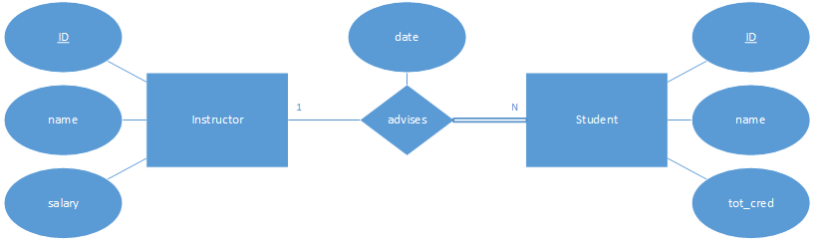
Chen’s Notation
Example

Slide 19
Overview
Weak entities
Relationship degrees
E-R diagrams
Chen’s notation
Crow’s foot notation
Specialization and generalization

Slide 20
Crow’s Foot Notation
Crow’s foot notation uses the following to illustrate E-R model components
Entities are represented using rectangles with 3 stacked compartments
The top compartment contains the entity name
Weak entities have no special representation
Attributes are represented within their entity’s compartments
The middle compartment contains the entity’s key(s), which may also include a key indicator (e.g. “PK”)
The bottom compartment contains the entity’s other attributes
Multivalued attributes have no special representation
Derived attributes have no special representation
Relationships are represented by dashed lines connecting entities
A description of the relationship is provided with these lines
Identifying relationships are represented using solid lines

Slide 21




Crow’s Foot Notation
Indicating relationship participation
Cardinality indicated by line endpoints
Zero or more
One or more
One and only one
Zero or 1
Additionally, an entity’s cardinality “upper bound” (a limit on the number of instances that may participate in the relationship) may be specified above the line and its “lower bound” (a minimum number of instances that may participate in the relationship) may be specified below the line

Slide 22
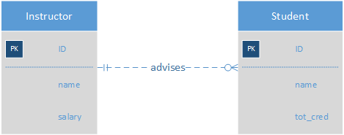
Crow’s Foot Notation
Example

Slide 23
Chen’s and Crow’s Foot Comparison
Chen’s notation is better suited for conceptual diagrams, as its design is more suited for systems that lack detail
Crow’s foot notation is better suited for logical and physical diagrams, as it allows for details that apply in that domain
However, it does not support n-ary relationships or relationship attributes
As a result, entities must be used for these purposes, which we’ll see translates well to a relational database

Slide 24
Overview
Weak entities
Relationship degrees
E-R diagrams
Chen’s notation
Crow’s foot notation
Specialization and generalization

Slide 25
Specialization and Generalization
Specialization occurs when multiple entities are designed to “reuse” the attributes in a single more generic entity
Generalization occurs when a single entity is designed to encapsulate common attributes pulled out of multiple more specific entities
Think inheritance in Java
Specialization is a “top down” approach while generalization is a “bottom up” approach

Slide 26
Specialization and Generalization
Example
Overlapping specialization
An entity instance can belong to multiple subentities
Indicated here using multiple arrows
Disjoint specialization
An entity instance can belong to only one subentity
Indicated here using
a single arrow

Slide 27
Entity-Relationship Model Diagrams
Create a Chen’s E-R diagram for the following system
DU keeps data on students including student ID, student name, campus address and phone number, permanent address and phone number, and email address
Data is also kept on courses that are offered, including the course call ID (like ‘COMP3421’), course name (like ‘Database Systems’), course description that appears in the catalog, the quarter offered (such as "Fall 2020”), section number, day, time, location, and instructor
Instructor data includes instructor ID, name, title, department, office location, and office phone number
Instructors teach course sections, instructors advise students, and students enroll in course sections

